Slide 1
Correlation
Notes:
https://docs.google.com/spreadsheets/d/1IwgftHmcPGa8ZVsklt6-K-ep4C7VezHZ3yhhqe6f3GA/edit#gid=1767382413

Slide 2
Correlation
As mentioned, covariance can give you information about the direction of the relationship between two variables but not about the strength of the relationship.
On the other hand, correlation indicated the strength of the relationship between two variables
The correlation coefficient can take values between -1 and +1.
A negative correlation coefficient implies that one variable increases as the other decreases, while a positive coefficient implies that both variables increase or decrease together (0 indicates no relationship)

Slide 3
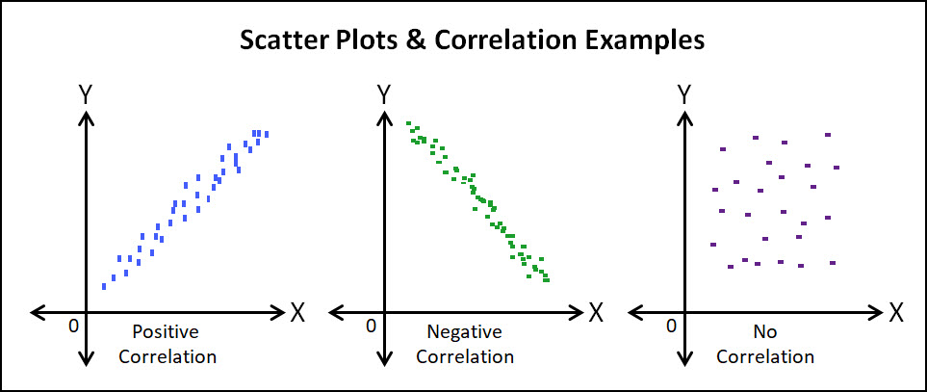
Correlation

Slide 4
Correlation
Correlation coefficient:
r_{XY} = ∑(x_{i} - μ_{x})(y_{i} - μ_{y}) / ( ∑(x_{i} - μ_{x})²(y_{i} - μ_{y})²)^{1/2}
This equation is normalized and constrained between -1 and +1, and hence is indicative of the strength of the relationship between two variables
Do correlation and dependence mean the same thing?

Slide 5
Correlation
Do correlation and dependence mean the same thing?
A non-dependence between two variables => 0 correlation
However, a zero correlation does not necessarily mean non-dependence.
Correlation can only capture linear relationship between variables. However, if two variables are related in a non-linear fashion, they could have a zero correlation. Hence, zero correlation does not necessarily mean non-dependence between variables

Slide 6
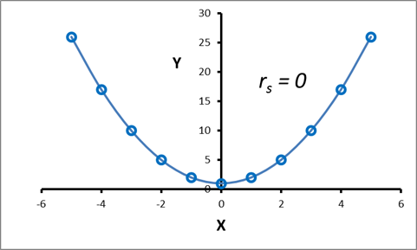
Correlation
Example: Dependent variables with 0 correlation Perfect quadratic relationship

Slide 7
Correlation
Q2: Calculate covariance and correlation for the following data set:
X: 3, 6, 10, 12 ( = 7.75)
Y: 8, 10, 12, 14 ( = 11)
Covariance:
Cov(X,Y)
= (3-7.75)(8-11)+(6-7.75)(10-11)+(10-7.75)(12-11)+(12-7.75)(14-11) /(4-1)
= 10.33

Slide 8
Correlation
Q2: Calculate covariance and correlation for the following data set:
X: 3, 6, 10, 12 ( = 7.75)
Y: 8, 10, 12, 14 ( = 11)
Correlation:
Cov(X,Y) = r_{XY} = ∑(x_{i} - μ_{x})(y_{i} - μ_{y}) / ( ∑(x_{i} - μ_{x})²(y_{i} - μ_{y})²)^{½}
Numerator: (3-7.75)(8-11)+(6-7.75)(10-11)+(10-7.75)(12-11)+(12-7.75)(14-11) = 30.99
Denominator: sqrt((3-7.75)²(8-11)²+(6-7.75)²(10-11)²+(10-7.75)²(12-11)²+(12-7.75)²(14-11)²) = 715.40
Hence, Corr(X, Y) = 0.04

